Slide 1
Training Recurrent Neural Network
Hung-yi Lee
Notes:
Read:
NAS
LSTM simple answer
GRU

Slide 2
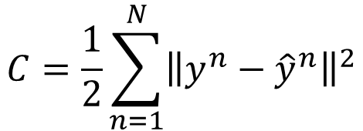


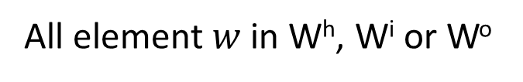



Goal
$${\hat{y}}^{1}$$
$${\hat{y}}^{2}$$
$${\hat{y}}^{3}$$
y¹
y²
y³
Wº
Wº
Wº
init
W^{h}
W^{h}
W^{h}
……
0
W^{i}
W^{i}
W^{i}
x¹
x²
x³
$$C=\frac{1}{2}\sum_{n=1}^{N}{{\left\|y^{n}−{\hat{y}}^{n}\right\|}^{2}}$$
All element $w$ in W^{h}, W^{i} or Wº
$$w←w−η∂C^{n}∕∂w$$
Backpropagation through time (BPTT)
$$C^{n}={\left\|y^{n}−{\hat{y}}^{n}\right\|}^{2}$$
Notes:
Backpropagation through time (BPTT)
RNN Training is very difficult in practice.

Slide 3
Review: Backpropagation
Error signal
Layer
Layer
Forward Pass
Backward Pass
…
…
…
…

Slide 4
Review: Backpropagation
Error signal
Layer L-1
Layer L
……
Backward Pass
……
…
…
……
…
…

Slide 5

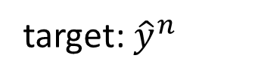

Backpropagation through Time
x^{n}
a^{n}
y^{n}
$${\hat{y}}^{n}$$
UNFOLD:
$$C^{n}$$
A very deep neural network
Input: init, x¹, x², … x^{n}
x^{n-1}
a^{n-1}
output: y^{n}
target: ${\hat{y}}^{n}$
x^{n-2}
a^{n-2}
x¹
a¹
……
……
init

Slide 6
Backpropagation through Time
x^{n}
a^{n}
y^{n}
$${\hat{y}}^{n}$$
UNFOLD:
$$C^{n}$$
A very deep neural network
Input: init, x¹, x², … x^{n}
x^{n-1}
a^{n-1}
output: y^{n}
target: ${\hat{y}}^{n}$
x^{n-2}
a^{n-2}
x¹
a¹
……
……
init
……

Slide 7


Backpropagation through Time
x^{n}
a^{n}
y^{n}
$${\hat{y}}^{n}$$
UNFOLD:
$$C^{n}$$
A very deep neural network
Input: init, x¹, x², … x^{n}
x^{n-1}
a^{n-1}
output: y^{n}
$${×\left(W^{o}\right)}^{T}$$
target: ${\hat{y}}^{n}$
x^{n-2}
a^{n-2}
$${×\left(W^{h}\right)}^{T}$$
x¹
a¹
……
init

Slide 8
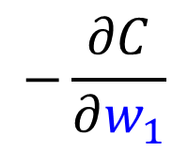
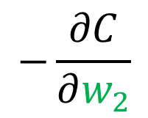
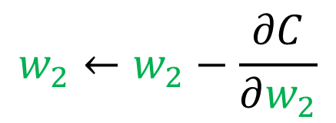
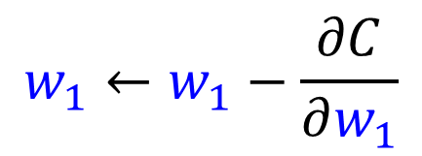


Backpropagation through Time
i
x^{n}
a^{n}
y^{n}
$${\hat{y}}^{n}$$
UNFOLD:
j
$$C^{n}$$
A very deep neural network
i
Input: init, x¹, x², … x^{n}
x^{n-1}
a^{n-1}
output: y^{n}
j
k
$$w_{2}$$
Initialize w₁, w₂
by the same value
target: ${\hat{y}}^{n}$
i
x^{n-2}
a^{n-2}
j
k
$$w_{1}←w_{1}−\frac{∂C}{∂w_{1}}$$
$$−\frac{∂C}{∂w_{2}}$$
$$w_{1}$$
pointer
i
$$w_{2}←w_{2}−\frac{∂C}{∂w_{2}}$$
$$−\frac{∂C}{∂w_{1}}$$
x¹
a¹
……
the same memory
j
pointer
Some weights are shared.
init
k
(The values of w₁, w₂ should always be the same.)

Slide 9
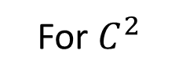




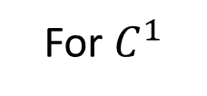


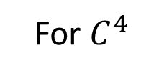

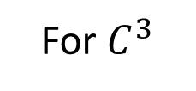

BPTT
Forward
Pass:
Compute a¹, a², a³, a⁴ ……
Backward
Pass:
For $C^{4}$
For $C^{3}$
For $C^{2}$
For $C^{1}$
$${\hat{y}}^{1}$$
$${\hat{y}}^{2}$$
$${\hat{y}}^{3}$$
$${\hat{y}}^{4}$$
$C^{1}$
$C^{2}$
$C^{3}$
$C^{4}$
y¹
y²
y³
y⁴
init
a¹
a²
a³
a⁴
x¹
x²
x³
x⁴
Notes:
If you consider y3, you can not ignore the history
(For multiple utterances
you should init again each time)

Slide 10
Unfortunately, it is not easy to train RNN.
Notes:
http://larseidnes.com/2015/10/13/auto-generating-clickbait-with-recurrent-neural-networks/

Slide 11
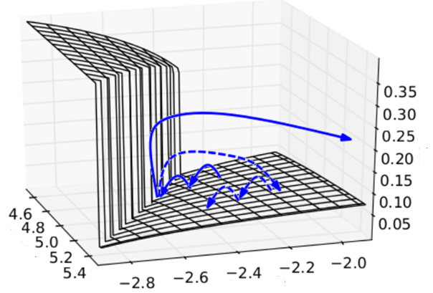

The error surface is rough.
The error surface is either very flat or very steep.
Cost
w₂
w₁
Source: http://jmlr.org/proceedings/papers/v28/pascanu13.pdf
Notes:
Even adagrad can not handle this problem, maybe RMS prop is better
Large or small is fine. Change quickly is bad

Slide 12











Toy Example
$$\frac{∂C^{n}}{∂w}=\frac{∂C^{n}}{∂y^{r}}\frac{∂y^{n}}{∂w}$$
$$\frac{∂y^{n}}{∂w}≈\frac{∆y^{n}}{∆w}$$
If n = 1000:
$$y^{n}=1$$
$$w=1$$
$$w=1.01$$
$$y^{n}≈20000$$
$$w=0.99$$
$$y^{n}≈0$$
$${\hat{y}}^{n}$$
$$w=0.01$$
$$y^{n}≈0$$
Cost C^{n}
y¹
y²
y³
y^{n}
1
1
1
1
1
……
w
w
w
w
1
1
1
1
0
0
0
0
Notes:
Echo state network

Slide 13
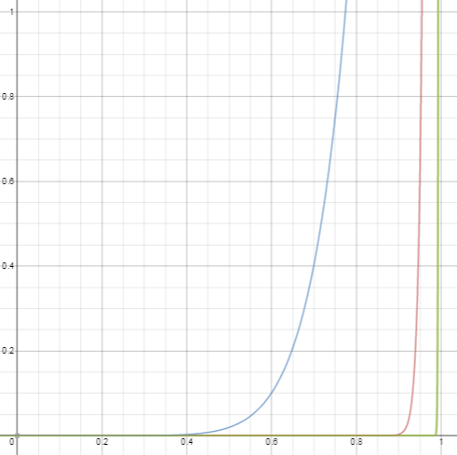
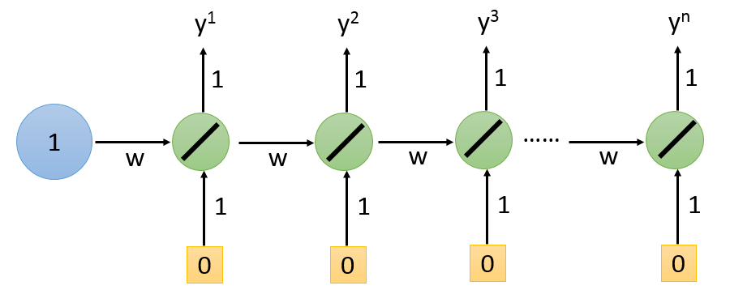


$$y^{n}={\left(w\right)}^{n}$$
n=10
$$\frac{∂y^{n}}{∂w}=n{\left(w\right)}^{n−1}$$
n=1000
Only extremely large and small value
n=100

Slide 14








Backpropagation through Time
x^{n}
a^{n}
y^{n}
$${\hat{y}}^{n}$$
Gradient Vanishing/Exploding
$$C^{n}$$
For simplicity, assume linear activation function
$$δ^{n}$$
x^{n-1}
a^{n-1}
$$δ^{n−1}$$
x^{n-2}
a^{n-2}
$$W={\left(W^{h}\right)}^{T}$$
$$δ^{n−2}$$
$$δ^{n−1}={Wδ}^{n}$$
x¹
a¹
……
$$δ^{n−2}={W^{2}δ}^{n}$$
$$δ^{1}$$
……
init
$$δ^{1}={W^{n−1}δ}^{n}$$

Slide 15
Gradient Vanishing/Exploding
1 step
2 steps
5 steps
10 steps
20 steps
50 steps

Slide 16
Possible Solutions
Notes:
Tony Robinson group was the only one that made RNN work for TIMIT speech (1994)
Cambridge
http://assta.org/sst/SST-90/cache/SST-90-Chapter13-p14.pdf

Slide 17
Clipped Gradient
Clipped gradient
theano.tensor.clip(x, min, max)
Cost
w₂
w₁
Source: http://jmlr.org/proceedings/papers/v28/pascanu13.pdf
Notes:
norm
Just random

Slide 18
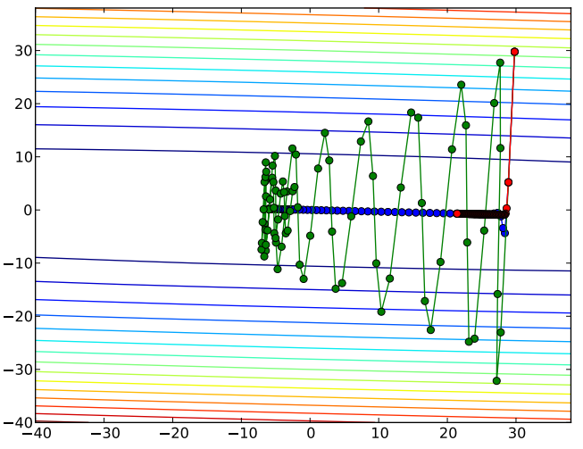
NAG
Methods:
Gradient descent
Valley
Momentum
Nesterov’s Accelerated Gradient (NAG)
Source: http://www.cs.toronto.edu/~fritz/absps/momentum.pdf

Slide 19
NAG
Gradient
Movement
Last Movement
Momentum
Nesterov’s Accelerated Gradient (NAG)
Gradient = 0
Gradient = 0
Notes:
探路、測風向

Slide 20
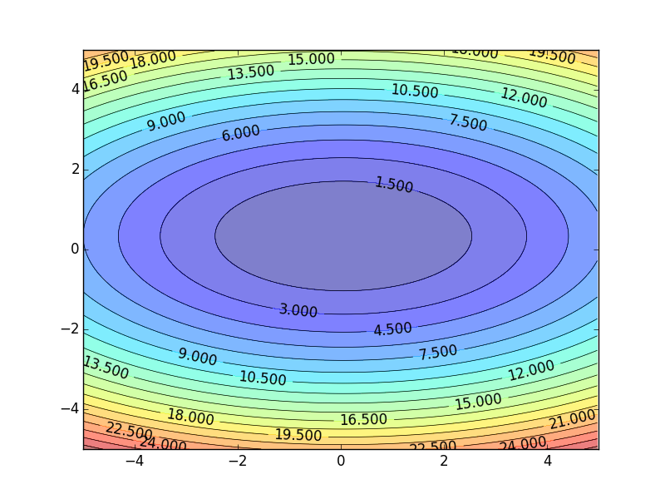
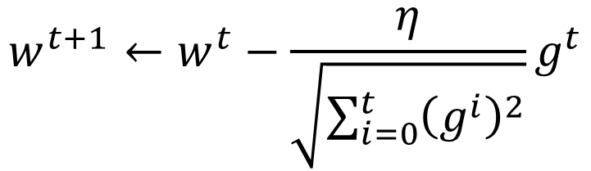


RMSProp
Smaller Learning Rate
$$w_{2}$$
Larger Learning Rate
Review:
Adagrad
$$w_{1}$$
$$w^{t+1}←w^{t}−\frac{η}{\sqrt{\sum_{i=0}^{t}{{\left(g^{i}\right)}^{2}}}}g^{t}$$
Use first derivative to estimate second derivative
Notes:
Larger Gradient
Smaller Learning
Rate

Slide 21
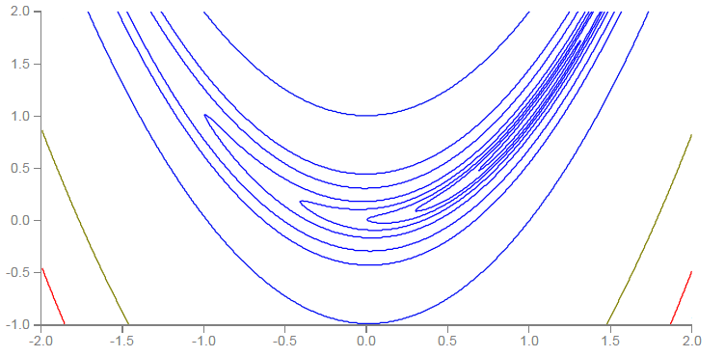


RMSProp
Error Surface can be even more complex when training RNN.
Smaller Learning Rate
$$w_{2}$$
Larger Learning Rate
$$w_{1}$$

Slide 22

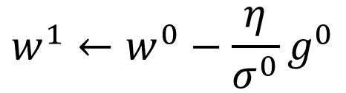

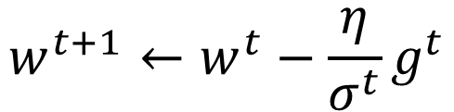

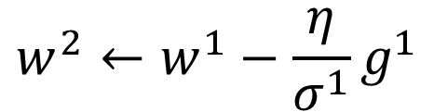


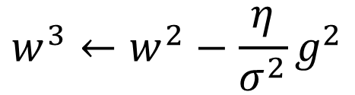
RMSProp
$$w^{1}←w^{0}−\frac{η}{σ^{0}}g^{0}$$
$$σ^{0}=g^{0}$$
$$w^{2}←w^{1}−\frac{η}{σ^{1}}g^{1}$$
$$σ^{1}=\sqrt{{α\left(σ^{0}\right)}^{2}+\left(1−α\right){\left(g^{1}\right)}^{2}}$$
$$w^{3}←w^{2}−\frac{η}{σ^{2}}g^{2}$$
$$σ^{2}=\sqrt{{α\left(σ^{1}\right)}^{2}+\left(1−α\right){\left(g^{2}\right)}^{2}}$$
$$……$$
$$w^{t+1}←w^{t}−\frac{η}{σ^{t}}g^{t}$$
$$σ^{t}=\sqrt{{α\left(σ^{t−1}\right)}^{2}+\left(1−α\right){\left(g^{t}\right)}^{2}}$$
Root Mean Square of the gradients with previous gradients being decayed
Notes:
Root Mean Squares of gradients

Slide 23
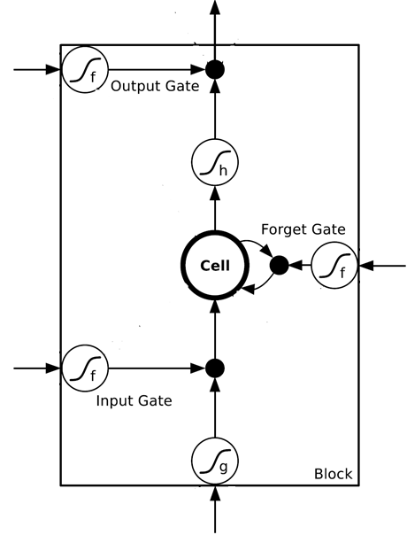


LSTM can address the gradient vanishing problem.
$$a_{1}$$
$$a_{2}$$
+
+
+
+
+
+
+
+
4 times of parameters
x₁
x₂
Input

Slide 24












LSTM
Extension: “peephole”
y^{t}
y^{t+1}
$$c^{t−1}$$
$$c^{t}$$
$$c^{t+1}$$
$$×$$
$$＋$$
$$×$$
$$×$$
$$＋$$
$$×$$
$$×$$
$$×$$
z^{f}
z^{i}
z
zº
z^{f}
z^{i}
z
zº
h^{t}
x^{t}
h^{t+1}
x^{t+1}
Notes:
C is vector

Slide 25




LSTM
$$δ⨀b$$
δ
a
a
b
$$＋$$
δ
b
$$×$$
δ
δ
$$δ⨀a$$
Constant Error Carrousel (CEC)
y^{t}
y^{t+1}
$$c^{t−1}$$
$$c^{t}$$
$$c^{t+1}$$
$$×$$
$$＋$$
$$×$$
$$×$$
$$＋$$
$$×$$
1
1
$$×$$
$$×$$
z^{f}
z^{i}
z
zº
z^{f}
z^{i}
z
zº
X W^{T}
X W^{T}
h^{t}
x^{t}
h^{t+1}
x^{t+1}
Notes:
C is vector
Math expression

Slide 26
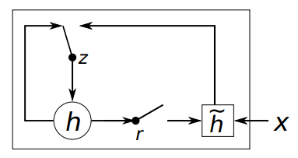
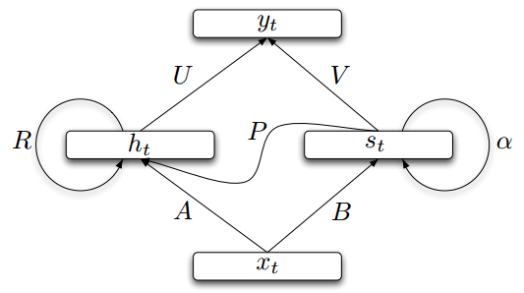
Other Simpler Variants
GRU: Cho, Kyunghyun, et al. "Learning Phrase Representations using RNN Encoder–Decoder for Statistical Machine Translation“, EMNLP, 2014
SCRN: Mikolov, Tomas, et al. "Learning longer memory in recurrent neural networks“, ICLR 2015
Notes:
Gated Recurrent Unit (GRU):
Structurally Constrained Recurrent Network (SCRN).

Slide 27
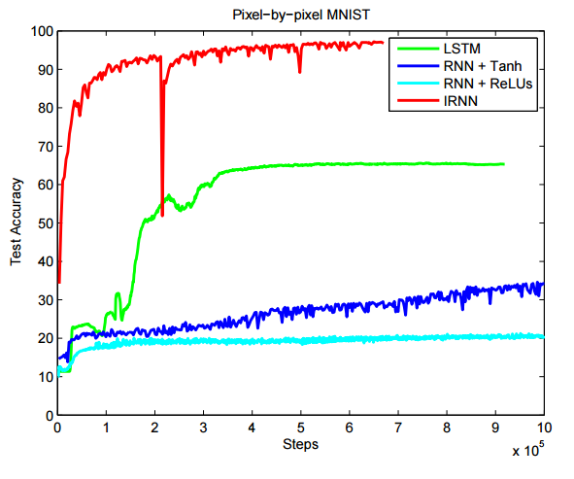
Better Initialization
Quoc V. Le, Navdeep Jaitly, Geoffrey E. Hinton, “A Simple Way to Initialize Recurrent Networks of Rectified Linear Units“, 2015
Vanilla RNN: Initialized with Identity matrix + ReLU

Slide 28
Concluding Remarks
Be careful when training RNN …
Possible solutions:
Clipping the gradients
Advanced optimization technology
NAG
RMSprop
Try LSTM (or other simpler variants)
Better initialization
Notes:
gated recurrent unit (GRU)

